Slide 1

Time, Talent, and Passion
Our Faith Moves Mountains
Utah
Catholic
Conference
Sept 2024
Elizabeth Kirts
Chuck Grahmann
St Thomas More
Parish Council President
St Thomas More Parishioner, CFU Board member, Proud Papa

Slide 2

We are always seeking volunteers – e.g. the time and talent of our members
Discuss an approach to build up volunteers and grow future leaders
  Welcoming
  The new opportunity
  Assign a mentor
  Assess progress
  Recognize leaders
  Service culture
  Enablers
  + Passion!
Time, Talent and Treasure
Notes:
Ask for a volunteer to assess what you get. Talk about own volunteer service and experiences. Volunteers- everyone is different

Slide 3

Welcome!
It starts with our first engagement at Mass
Greet everyone
Seek out new & old faces and learn their names
Make me comfortable to be here
How ‘I’ am treated
“Those people are great”
Notes:
Its easy to get into a rut and sit in the same place and only interact with the same people. One thing that we have tried is asking people to sit in a new spot.

Slide 4

The new opportunity
I am interested in / I want to do…
Grab their phone number and email
Ensure that someone WILL follow up
They are excited - now
Get them into a ministry

Slide 5

Assign a mentor
Mentors should be knowledgeable and supportive
Get them to meetings
Introduce them to key members
Assign them to a group / a task
Ask for feedback
This is a period of evaluation
Notes:
Different people need different levels of support and mentorship. A hard part of mentoring is giving up or giving over. Sometimes we want it done our way and the person has a different idea.

Slide 6

Assess progress
How are they feeling and doing?
Ensure good communication
I can’t do much more at this time
Tomorrow they may be ready for more
Feedback
Notes:
All of us have different times in our lives when we can do more or we can’t.

Slide 7
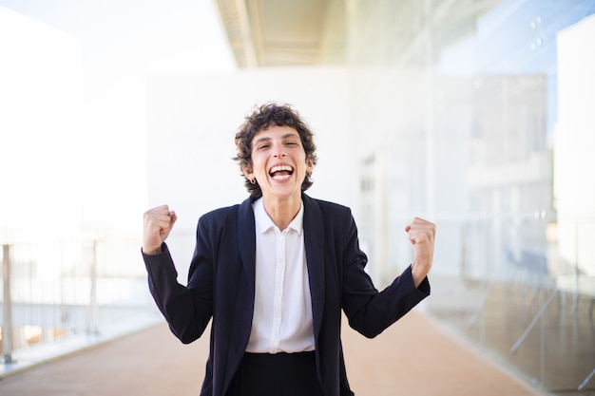
Recognize leaders
Observe their early successes
Ensure recognition of their early wins
Continue to mentor
Offer them greater roles when ready
Help them reach their highest potential
Feedback

Slide 8
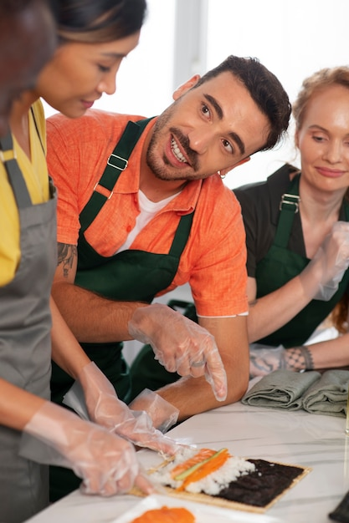
Service culture
You have got to ask
Consider a ministry fair
Ask a friend
Go get your next volunteer
A previous ‘no’ can become a ‘yes’

Slide 9

Enablers
Those who enable others to achieve
Who do I see about this?
What resources do we have?
I’m feeling resistance
Ideal candidates – past ministry leaders

Slide 10

Passion
Do what you love and have fun!
Volunteering is inherently rewarding
Make it a labor of love
Have fun
Change it up every few years

Slide 11
Time, Talent and Passion
Welcoming
The new opportunity
Assign a mentor
Time, Talent
Assess progress
Recognize leaders
Service culture
Enablers
Passion

Slide 12




Questions?
Our Faith Moves Mountains
Utah
Catholic
Conference
Sept 2024
Elizabeth Kirts
801.556-6-5909
Elizabeth.kirts@hsc.Utah.edu
St Thomas More Parish
Chuck Grahmann
801 673 0238
cgrahmann1@gmail.com
St Thomas More Parish

